Slide 1
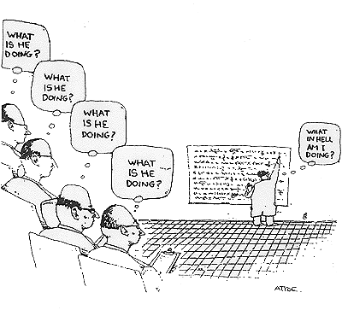
Hypothesis Testing with t Tests
Arlo Clark-Foos

Slide 2
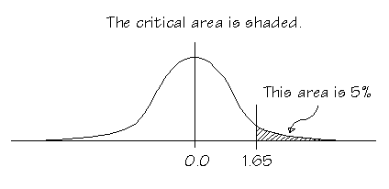
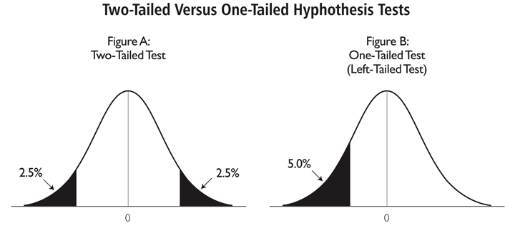
What have we done so far?
Hypothesis Testing & Inferential Statistics
alpha levels, cut-offs, p-value
One-tailed vs. Two-tailed tests
Goal: Estimate likelihood of obtaining sample mean given some known population parameters (μ and σ)
What if we didn’t know all of the population parameters?

Slide 3

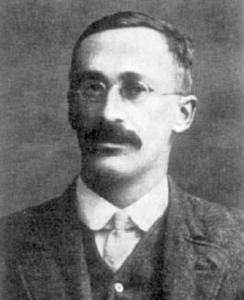

The Story of Student’s t
“Guinness is the best beer available, it does not need advertising as its quality will sell it, and those who do not drink it are to be sympathized with rather than advertised to.” --W.S. Gosset (aka “Student”)
The pros and cons of beer sampling…

Slide 4
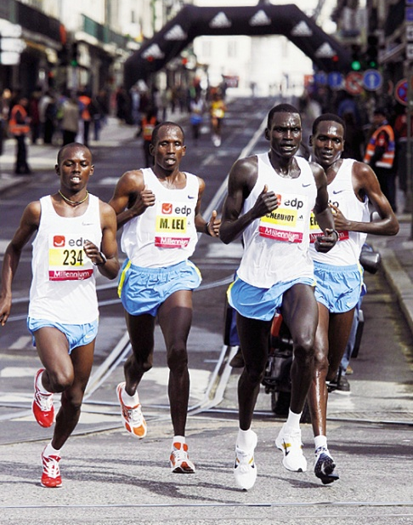
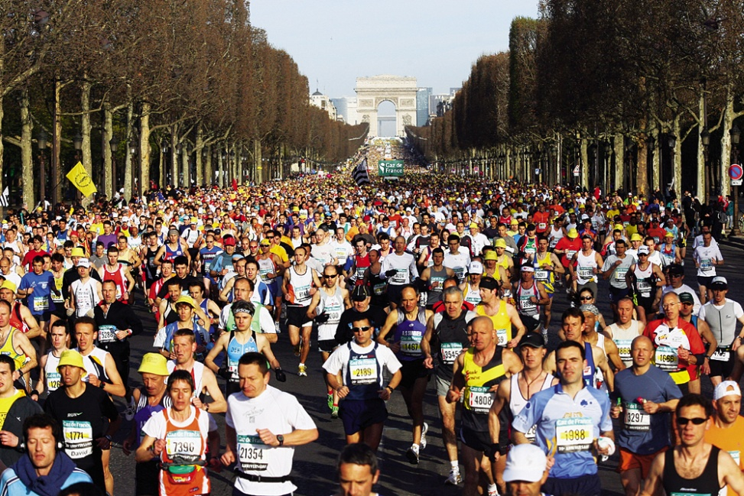
Using Samples to Estimate Population Variability
Acknowledge error
Smaller samples, less spread
New!
This correction will affect larger samples less so than it will affect smaller samples.
N = 65, N – 1 = 64 (change of 1.5%)
N = 4, N – 1 = 3 (change of 25%)

Slide 5

What happened to σ_{M}?
Still there, only used for z tests
We have a new measure of standard deviation for a sample (as opposed to a population): s
We need a new measure of standard error based on sample standard deviation:
Wait, what happened to “N-1”?
We already did that when we calculated s, don’t correct again!

Slide 6
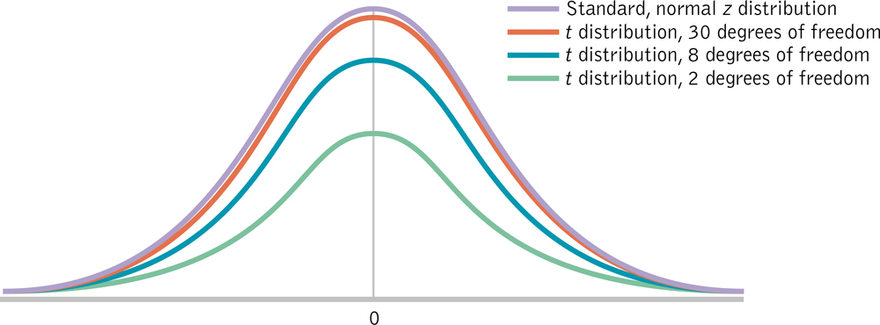
Student’s t Statistic
Indicates the distance of a sample mean from a population mean in standard errors (like standard deviations)

Slide 7

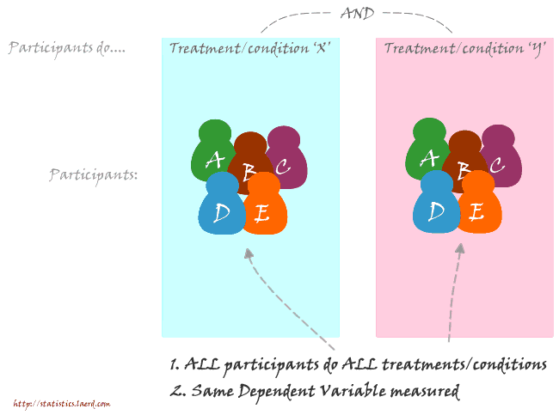
The many flavors of tea
Single sample t
One sample, compared with known population mean
Goal: Is our sample different from population?
Independent Samples t
Different (independent) samples of participants
experience each level of IV
Are our samples from different
populations?
Paired/Dependent Samples
Same or related (dependent) samples
of participants experience each level of IV
Are our samples from different
populations?

Slide 8
Degrees of Freedom
Necessary when making estimates…
The number of scores that are free to vary when estimating a population parameter from a sample
df = N – 1 (for a Single-Sample t Test)
Example: I decide to ask 6 people how often they floss their teeth and record their average = 2 (times per week)
Eventual goal: Estimate population parameters (population variability).
How many scores are free to vary and can still produce an average of 2?
3 | Free | 2
5 | Free | 1
1 | Free | 0
0 | Free | 0
2 | Free | 0
1 | LOCKED | 9
Average = 2 |  | Average = 2

Slide 9
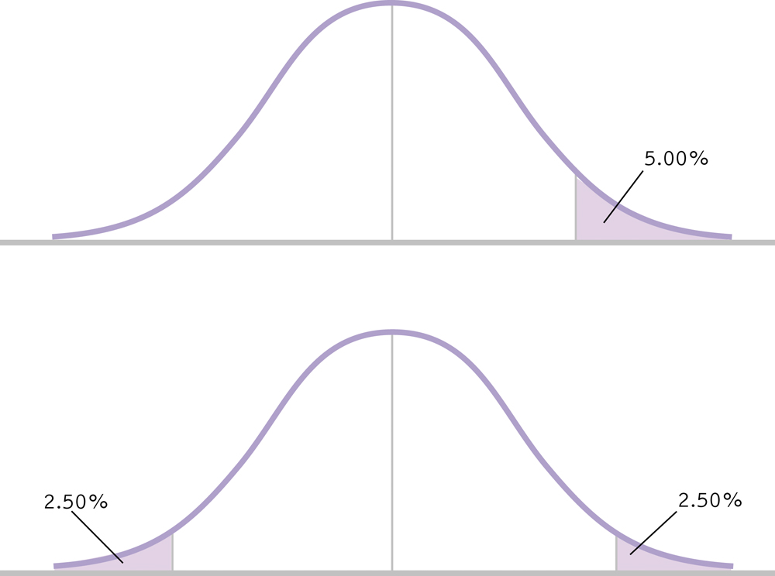
One Tailed vs. Two Tailed Tests

Slide 10

Six Steps for Hypothesis Testing
1. Identify
2. State the hypotheses
3. Characteristics of the comparison distribution
4. Critical values
5. Calculate
6. Decide
old hat

Slide 11
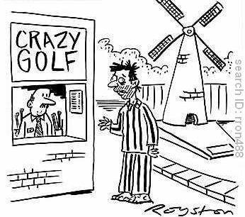
Single-Sample t Test: Attendance in Therapy Sessions
Our Counseling center on campus is concerned that most students requiring therapy do not take advantage of their services. Right now students attend only 4.6 sessions in a given year! Administrators are considering having patients sign a contract stating they will attend at least 10 sessions in an academic year.
Question: Does signing the contract actually increase participation/attendance?
We had 5 patients sign the contract and we counted the number of times they attended therapy sessions
Number of Attended Therapy Sessions
6
6
12
7
8

Slide 12
Single-Sample t Test: Attendance in Therapy Sessions
Identify
Populations:
Pop 1: All clients who sign contract
Pop 2: All clients who do not sign contract
Distribution:
One Sample mean: Distribution of means
Test & Assumptions: Population mean is known but not standard deviation → single-sample t test
Data are interval
Probably not random selection
Sample size of 5 is less than 30, therefore distribution might not be normal

Slide 13
Single-Sample t Test: Attendance in Therapy Sessions
State the null and research hypotheses
H₀: Clients who sign the contract will attend the same number of sessions as those who do not sign the contract.
H₁: Clients who sign the contract will attend a different number of sessions than those who do not sign the contract.

Slide 14
Single-Sample t Test: Attendance in Therapy Sessions
Determine characteristics of comparison distribution (distribution of sample means)
Population: μ_{M} = μ = 4.6times
Sample: M = ____times, s = _____, s_{M} = ______
7.8
2.490
1.114
# of Sessions (X)
6
6
12
7
8
M_{X} = 7.8
X-M
-1.8
-1.8
-4.2
-0.8
0.2
(X-M)²
3.24
3.24
17.64
0.64
0.04
SS_{X} = 24.8

Slide 15
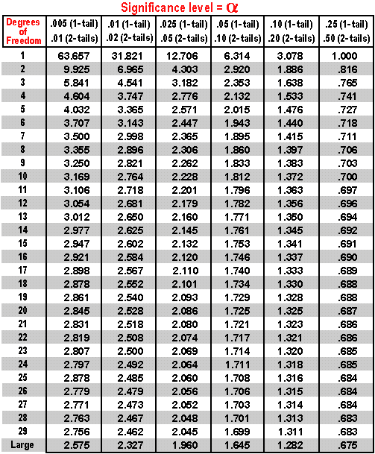
Single-Sample t Test: Attendance in Therapy Sessions
μ_{M} = 4.6, s_{M} = 1.114, M = 7.8, N = 5, df = 4
Determine critical value (cutoffs)
In Behavioral Sciences, we use p = .05 (5%)
Our hypothesis (“Clients who sign the contract will attend a different number of sessions than those who do not sign the contract.”) is nondirectional so our hypothesis test is two-tailed.
df = 4

Slide 16
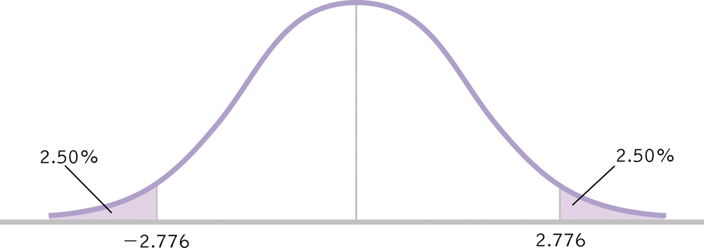
Single-Sample t Test: Attendance in Therapy Sessions
μ_{M} = 4.6, s_{M} = 1.114, M = 7.8, N = 5, df = 4
Determine critical value (cutoffs)
t_{crit} = ± 2.76

Slide 17
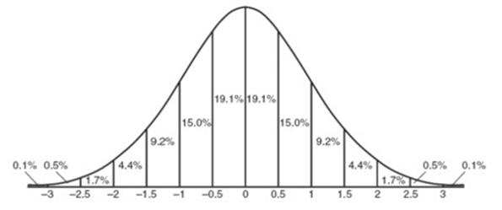
Single-Sample t Test: Attendance in Therapy Sessions
μ_{M} = 4.6, s_{M} = 1.114, M = 7.8, N = 5, df = 4
Calculate the test statistic
Make a decision
-2.76
+2.76

Slide 18
Single-Sample t Test: Attendance in Therapy Sessions
μ_{M} = 4.6, s_{M} = 1.114, M = 7.8, N = 5, df = 4
Make a decision
t = 2.873 > t_{crit} = ±2.776, reject the null hypothesis
Clients who sign a contract will attend more sessions than those who do not sign a contract,
t(4) = 2.87, p < .05.
2.873

Slide 19
Reporting Results in APA Format
Write the symbol for the test statistic (e.g., z or t)
Write the degrees of freedom in parentheses
Write an equal sign and then the value of the test statistic (2 decimal places)
Write a comma and then whether the p value associated with the test statistic was less than or greater than the cutoff p value of .05 (or report exact p value).
t(4) = 2.87, p < .05

Slide 20
Another example? A Tale of a Tail
The citizens of several Georgia towns are worried that a fiberglass insulation plant is polluting the local environment. A doctor at one hospital, Our Sister of the Failing Mercy, noted 3 babies born with a coccycx (tailbone) in the past year. Digging deeper she read a report in Human Pathology (Dao & Netsky, 1984) that between 1884 and 1984 only 23 babies were born with tails. She believes her hospital data to be unusual but she also writes to doctors at 8 other hospitals to determine how often they had seen this birth defect in the past year (these data are below).
Hospital | # of Tails
North Shore | 2
Town Center | 0
St. Mary | 0
University | 1
Failing Mercy | 3
South Central | 1
Oakmont | 0
Bellevue | 1
East Valley | 0
∑ = 8
N = 8
M = 1
“between 1884 and 1984 only 23 babies were born with tails…”
23 babies in 100 years (µ ) = .23

Slide 21
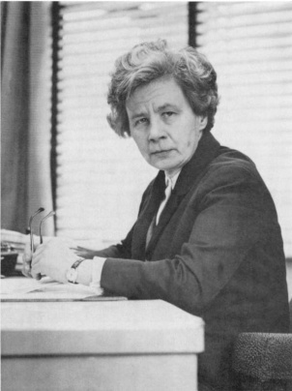
Rolling Kegs for Fun and Profit
Making the perfect handmade cask
Not too big (too much beer, lower profits)
Not too small (not enough beer, fewer clients)
Expectation: High rejection of poorly sized casks
Data: Little-to-no rejections…why?
Visit workstation for employee making rejections.
Conditions must be equal in order to make a fair comparison.
“how impossible it is to find human beings without biases, without prejudices, and without the delightful idiosyncrasies which make them so fascinating.” (Cunliffe, 1976, p.5)
Stella Cunliffe

Slide 22
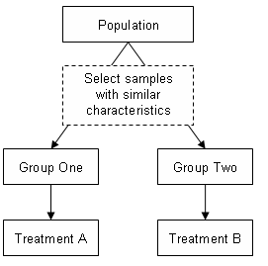
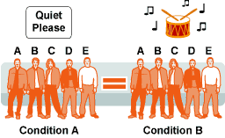
Studies with Two Samples
Independent
What is it?
Pros
Cons
Paired (Dependent)
What is it?
Pros
Cons
Hypothetical Beer Tasting Experiment
What is the ideal design for this study?

Slide 23
Paired Samples t Test
Two Related (dependent) samples

Slide 24
Paired-Samples t Test
Used to compare 2 means for a within-groups design, a situation in which every participant is in both samples (paired/dependent)
New Terminology
Distribution of Mean Differences
Difference Scores: X₁ – Y₁, X₂ – Y₂, …
Let’s walk through an example…

Slide 25
Six Steps for Hypothesis Testing
1. Identify
2. State the hypotheses
3. Characteristics of the comparison distribution
4. Critical values
5. Calculate
6. Decide
old hat

Slide 26
Paired Samples t Test: Does Studying in the Exam Room Help?
I have a debate with a research assistant about context effects in studying for exams. She believes that she does far better when she studies for an exam in the same room as she later takes the exam. I told her that I could see it either hurting or helping students. We agreed to have a group of 5 participants complete two highly similar math exams. Half of these participants studied for and completed the exams in the same room while the other half were in different rooms, order counterbalanced*. Data for SAME and DIFFERENT rooms are below.
Difference Score X-Y
-11
-15
-14
-4
-11
SAME (X) | DIFFERENT (Y)
122 | 111
131 | 116
127 | 113
123 | 119
132 | 121
M = -11

Slide 27
Paired Samples t Test: Does Studying in the Exam Room Help?
Identify
Populations:
Pop 1: Exam grades when studying and testing are in the same room.
Pop 2: Exam grades when studying and testing are in different rooms.
Distribution:
Mean of Difference Scores: Distribution of Mean Differences
Test & Assumptions: One group of participants that is studied at two time points, paired-samples t test
Data are interval
Probably not random selection
Sample size of 5 is less than 30, therefore distribution might not be normal

Slide 28
Paired Samples t Test: Does Studying in the Exam Room Help?
State the null and research hypotheses
H₀: Studying and testing in the same room will result in the same grade as studying and testing in different rooms.
H₁: Studying and testing in the same room will result in a different grade than studying and testing in different rooms.

Slide 29
Paired Samples t Test: Does Studying in the Exam Room Help?
Determine characteristics of comparison distribution (distribution of mean differences)
Population: μ_{M} = 0 (i.e., no mean difference)
Sample(s): M = 11, s = 4.301, s_{M} = 1.923
Difference Score X-Y
-11
-15
-14
-4
-11
M = -11
Deviation Score (Score - Mean)
0
-4
-3
7
0
Squared Deviation (Score - Mean)²
0
16
9
49
0
SS_{X} = 74

Slide 30
Paired Samples t Test: Does Studying in the Exam Room Help?
μ_{M} = 0, s_{M} = 1.923, M = -11, N = 5, df = 4
Determine critical value (cutoffs)
In Behavioral Sciences, we use p = .05 (5%)
Our hypothesis (“Studying and testing in the same room will result in a different grade than studying and testing in different rooms.”) is nondirectional so our hypothesis test is two-tailed.
df = 4

Slide 31
Paired Samples t Test: Does Studying in the Exam Room Help?
μ_{M} = 0, s_{M} = 1.923, M = -11, N = 5, df = 4
Determine critical value (cutoffs)
t_{crit} = ± 2.76

Slide 32
Paired Samples t Test: Does Studying in the Exam Room Help?
μ_{M} = 0, s_{M} = 1.923, M = -11, N = 5, df = 4
Calculate the test statistic
Make a decision
-2.76
+2.76

Slide 33
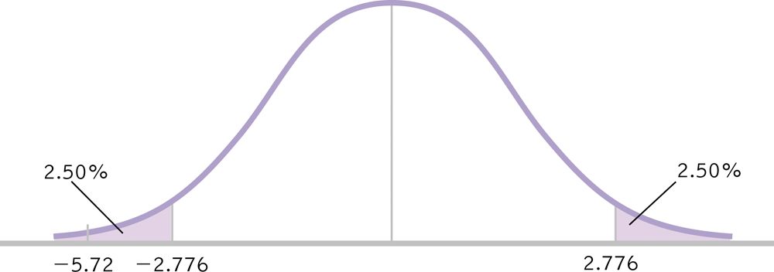
Paired Samples t Test: Does Studying in the Exam Room Help?
μ_{M} = 0, s_{M} = 1.923, M = 11, N = 5, df = 4
Make a decision
t = -5.720 > t_{crit} = ±2.776, reject the null hypothesis
People studying and testing in different rooms performed worse than … in the same rooms,
t(4) = 5.72, p < .05.

Slide 34
Paired Samples: Ideal Design?
Given the simple calculations and low cost (time and participants), why wouldn’t we always use paired/dependent/within subjects designs?
Back to the hypothetical beer tasting experiment…

Slide 35
Independent Samples t Test
Two Unrelated (unpaired) samples

Slide 36
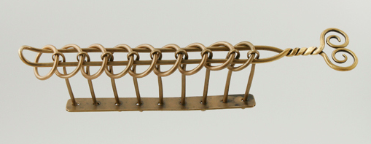
My Father’s “Chinese Lock”
Does teaching someone a strategy decrease the amount of time it takes to solve the puzzle?
How do you design this study?
Paired Samples option #1: No Strategy → Strategy
Paired Samples option #2: Strategy → No Strategy

Slide 37
Independent Samples t Test
Used to compare 2 means for a between-groups design, a situation in which each participant is assigned to only one condition.
New Statistics & Terminology:
Distribution of Differences Between Means
df_{X} , df_{Y} , df_{Total}
Pooled Variance
Standard Error of the Difference

Slide 38
Six Steps for Hypothesis Testing
1. Identify
2. State the hypotheses
3. Characteristics of the comparison distribution
4. Critical values
5. Calculate
6. Decide
old hat

Slide 39
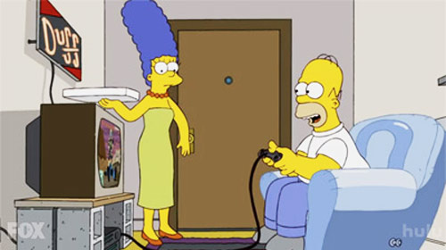
Independent Samples t Test: Gender Differences in Humor Appreciation
I tend to believe that very few differences exist between males and females in cognitive abilities but there is some evidence that there are gender differences in, for example, humor appreciation.

Slide 40

Independent Samples t Test: Gender Differences in Humor Appreciation
In this hypothetical study we ask: what percentage of cartoons do men and woman consider funny? We recruited 9 people from the psychology subject pool and asked them to view a cartoon. After the cartoon, each participant gave us a humor rating of the cartoon, from 0-100 (100 being the funniest possible). Here are those data.
Women (X) | Men (Y)
84 | 88
97 | 90
58 | 52
90 | 97
 | 86

Slide 41
Independent Samples t Test: Gender Differences in Humor Appreciation
Identify
Populations:
Pop 1: Women exposed to the cartoon
Pop 2: Men exposed to the cartoon
Distribution:
Difference Between Means: Distribution of Differences Between Means
Not Distribution of Mean Differences
Test & Assumptions: One group of participants that is studied at two time points, paired-samples t test
Data are interval
Random selection
Sample size of 9 is less than 30, therefore distribution might not be normal

Slide 42
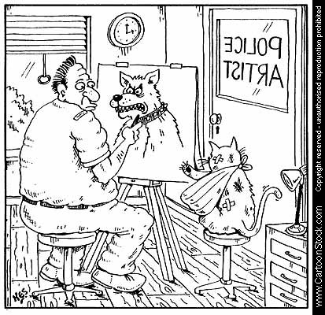
Independent Samples t Test: Gender Differences in Humor Appreciation
State the null and research hypotheses
H₀: Women will categorize the same number of cartoons as funny as will men.
H₁: Women will categorize a different number of cartoons funny than will men.

Slide 43
Independent Samples t Test: Gender Differences in Humor Appreciation
Determine characteristics of comparison distribution (distribution of differences between means)
Population: μ₁ = μ₂ (i.e., no difference between means)
What the @#$% ?

Slide 44
Independent Samples t Test: Gender Differences in Humor Appreciation
Determine characteristics of comparison distribution
S_{Difference}
Standard Error of the Difference:
Calculate variance for each sample
Pool variances, accounting for sample size
Convert from squared standard deviation to squared standard error
Add the two variances
Take square root to get estimated standard error for distribution of differences between means.

Slide 45
Calculating s_{Difference}
Calculate variance (s²) for each sample
Women (X) | X-M | (X-M)²
84 | 1.75 | 3.063
97 | 14.75 | 217.563
58 | -24.25 | 588.063
90 | 7.75 | 60.063
M_{X} = 82.25
SS_{X} = 868.752
Men (Y) | Y-M | (Y-M)²
88 | 5.4 | 29.16
90 | 11.4 | 129.96
52 | -30.6 | 936.36
97 | 14.4 | 207.36
86 | 3.4 | 11.56
M_{Y} = 82.6
SS_{Y} = 1314.4

Slide 46
Independent Samples t Test
New Types of Samples Means…
New Degrees of Freedom
df_{X} = N – 1 = 4 – 1 = 3
df_{X} = 3
df_{Y} = N – 1 = 5 – 1 = 4
df_{Y} = 4
df_{Total} = df_{X} + df_{Y} = 3 + 4 = 7
df_{Total} = 7
Women (X)
84
97
58
90
N = 4
Men (Y)
88
90
52
97
86
N = 5

Slide 47
Pooled Variance
Pool variances, accounting for sample size
Weighted average of the two estimates of variance – one from each sample – that are calculated when conducting an independent samples t test.

Slide 48
Independent Samples t Test: Gender Differences in Humor Appreciation
Convert from squared standard deviation to squared standard error
Add the two variances
Take square root to get estimated standard error for distribution of differences between means.

Slide 49
Independent Samples t Test: Gender Differences in Humor Appreciation
Determine critical value (cutoffs)
In Behavioral Sciences, we use p = .05 (5%)
Our hypothesis (“Women will categorize a different number of cartoons funny than will men.”) is nondirectional so our hypothesis test is two-tailed.
t = ± 2.365
df_{Total} = 7

Slide 50
Independent Samples t Test: Gender Differences in Humor Appreciation
Determine critical values
df_{Total} = 7 p = .05 t = ± 2.365
Calculate a test statistic

Slide 51
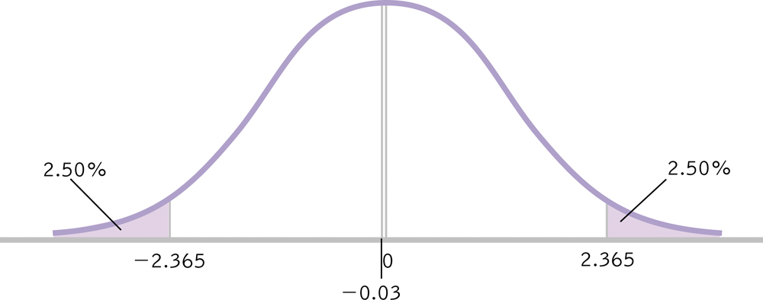
Independent Samples t Test: Gender Differences in Humor Appreciation
Make a decision
Fail to reject null hypothesis
Men and women find cartoons equally humorous, t(7) = .03, p > .05

Slide 52
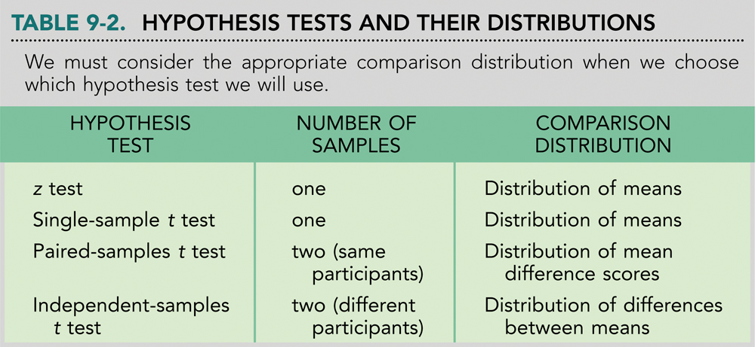
Summary

